Slide 1

If the Map Fits
Edmond Leahy
Esther Cho
Kiera Fulton

Slide 2
Agenda
Overview
Team
Performance Framework
Risks
Plan
Budget

Slide 3
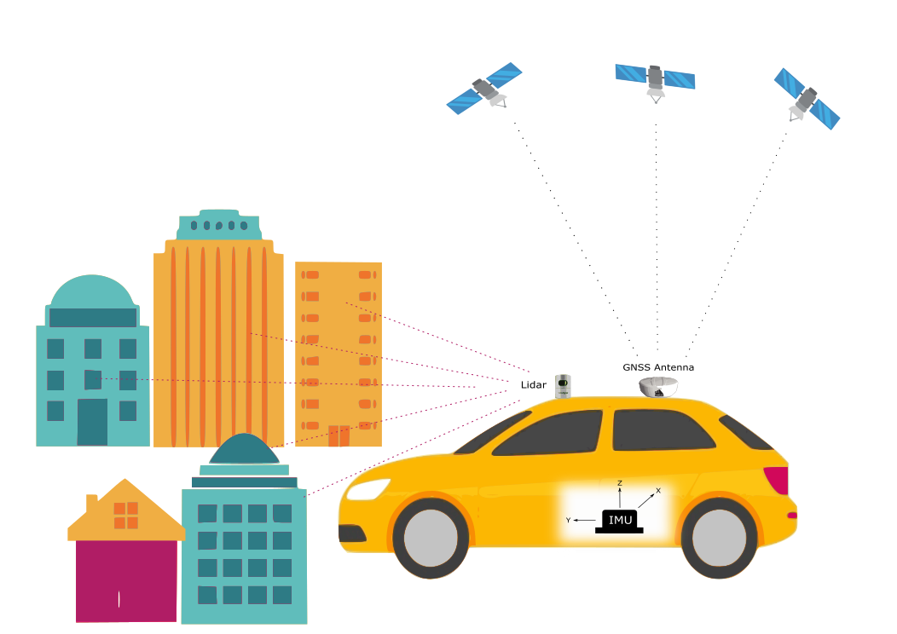
Project Overview

Slide 4
Mobile Mapping System (MMS)

Slide 5
Mobile Mapping System (MMS)
3D data collection of geospatial data
Imaging and ranging sensors (lidar)
Navigation components (GNSS and INS) are used to georeference the imaging data

Slide 6
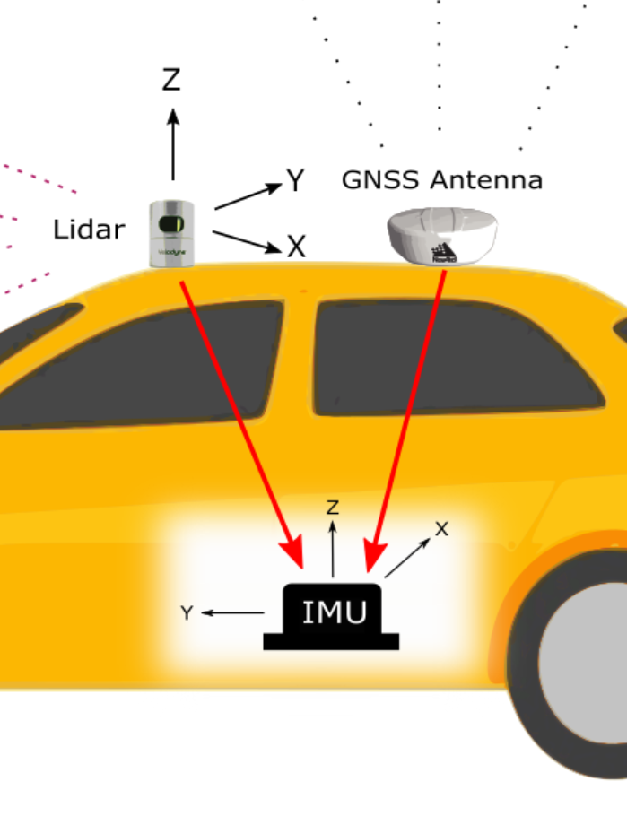
Problem
Must determine relative orientation of lidar sensor with respect to navigation sensors
Solved through boresight calibration
Notes:
- Mobile Mapping systems use 3D data collected from various instruments. How can they be combined in a useful manner, easily?
- The problem is finding the relative orientations of the liDAR system with respect to the known system used for the navigation sensors.

Slide 7
Boresight Calibration
Boresight matrix: rotational differences between the two coordinate systems
Lever-arm offsets: translational offsets between the origins of each coordinate system
Notes:
- Mobile Mapping systems use 3D data collected from various instruments. How can they be combined in a useful manner, easily?
- The problem is finding the relative orientations of the liDAR system with respect to the known system used for the navigation sensors.

Slide 8
Project Team

Slide 9
Student Team
Edmond
Esther
Kiera
Developing algorithms and code
Data collection
Technical analysis
Technical writing
Verification of data and code
Post-processing
Technical analysis
Technical writing
Project Management
Communications with sponsor and supervisor
Technical analysis
Technical writing

Slide 10

About novatel
Leading provider of GNSS positioning technology
collect and post-process with NovAtel’s GNSS + INS products and Inertial Explorer software
we will be seeking their guidance from Novatel’s engineers throughout this project.

Slide 11

About Dr. Mozhdeh Shahbazi
Supervisor of our project
Expert in geomatics and photogrammetry
Will be guiding us through the technical aspects of boresight calibration

Slide 12
Project Performance Framework
Data Collection, Calibration Algorithm, and Algorithm Robustness
Notes:
Data Collection: Simultaneously collect data from all three sensors, in a manner that will be useful for creating the algorithm. Includes: Different scenario, speed, sampling etc.
Calibration algorithm: Using the data collected, we will create an algorithm that solves for the platform calibration parameters: Boresight angles and Lever arms. Intrinsic parameters may be solved for separately.
Algorithm Robustness: Using the multiple scenarios collected, the algorithm will be augmented to be more robust, more useful for mobile mapping scenarios.

Slide 13
Milestones
Data
Code
Code Verification
Analytics
Presentation
Notes:
- Create an algorithm that uses 3 raw observation files (one from each MMS or sensor), and produces usable boresight and lever arm calibration parameters under varying data collection environments.

Slide 14
Project performance measurement plan
Item | Objectives | Outputs | Outcomes | Criteria
Collection | Data | Observation | Learning | 3 Observation files
Calibration | Create Algorithm | Parameters | Learning | Algorithm
Robustness | Verification | Stable parameters | Learning | Robust Algorithm
Notes:
Data Collection: Collect useful data for calibration. Observation files. Learning about data from each sensor. 3 useful observation files
Calibration: Create useful algorithm for solving parameters. Bore-sight parameters and Lever arms. Learning the algorithm. A completed algorithm.
Robustness: Test stability of algorithm. Stable algorithm. Learning how different datasets react to calibration. Robust and stable algorithm.

Slide 15
The data
Sensor | Raw Data | Post-Processed Data
GNSS Receiver | Range measurements from receiver to satellites | Coordinates of IMU center
IMU | Accelerometer and gyroscope measurements | Coordinates of IMU center
Lidar | Range and angle measurements | 3D point cloud to be georeferenced
Notes:
- Mobile Mapping systems use 3D data collected from various instruments. How can they be combined in a useful manner, easily?
- The problem is finding the relative orientations of the liDAR system with respect to the known system used for the navigation sensors.

Slide 16
Project riskS

Slide 17
Risks
Description | Impact | Probability
Losing data, code,& other work | H | L
Multipath/interference causing poor data | M | M
Lack of time management | M | L
Team members/supervisors unavailable or go on extended leave. | M | L
Extreme weather preventing data collection | L | L

Slide 18
Project plan

Slide 19
Project schedule: Phase 1
Initial Data Collection
October 31 – November 19
Gather resources (GNSS receiver, IMU, lidar, test vehicle)
Perform data collection in moderately obstructed environment
Post-processing of data

Slide 20

Project schedule: Phase 2
Develop algorithm/code
October 31 – December 18
Pseudo-code while waiting for data
Compute boresight parameters
Georeference imaging data

Slide 21
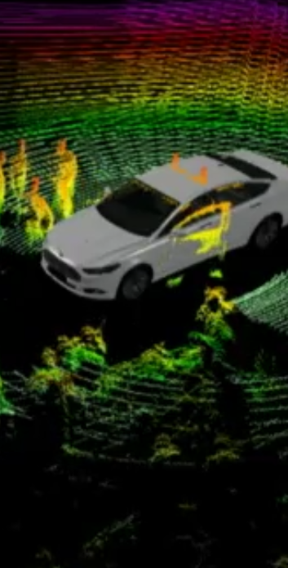
Project schedule: Phase 3
Data collection in different environments
January 7 – February 6
Collect data in new environments:
Open sky
Highway – High speed
Tunnel
Foliage

Slide 22

Project schedule: Phase 4
Code verification
February 6 – February 13
Test code on new datasets
Debugging

Slide 23

Project schedule: Phase 5
Analysis
February 14 – February 22
Determine stability of the solution
Plotting and interpretation of results

Slide 24

Project schedule: Phase 6
Presentation
February 25 – March 6
Gather results
Create presentation material
Capstone fair

Slide 25
Budget
Expense | Amount | Comment
Van Rental | N/A | Provided by NovAtel
GNSS Receiver Rental | N/A | Provided by NovAtel
IMU Rental | N/A | Provided by NovAtel
Inertial Explorer License | N/A | Inertial Explorer processing for GNSS + INS provided by NovAtel
Lidar post-processing software | N/A | LiDAR point cloud viewing, and CAD modelling provided through U of C

